Slide 1
Organic Farming

Slide 2
Content
What is Organic Farming?
Need of Organic Farming
Key characteristics
Four Principle
Advantages
Disadvantages

Slide 3
Organic Farming
Organic farming is a system which avoids or largely excludes the use of synthetic inputs (such as fertilizers, pesticides, hormones, feed additives etc.) and to the maximum extent feasible rely upon crop rotations, crop residues, animal manures, off-farm organic waste and mineral grade rock additives

Slide 4
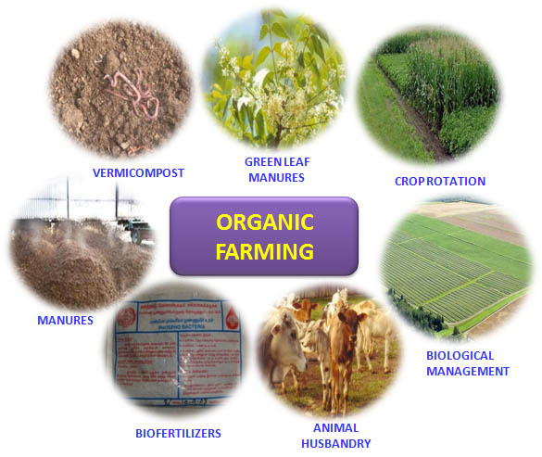
Organic Farming

Slide 5
Need Of Organic Farming
Increase in population make compulsion to stabilize agricultural production, but to, increase it further, in sustainable manner.
Natural balance needs to be maintained at all cost for existence of life and property.
Agrochemicals which are produced from fossil fuel and are not renewable and are diminishing in availability.

Slide 6
Key Characteristics
Protecting the long-term fertility of soils by maintaining organic matter levels, encouraging soil biological activity and careful mechanical intervention.
Providing crop nutrients which are made available to the plant by the action of soil micro-organisms-.

Slide 7
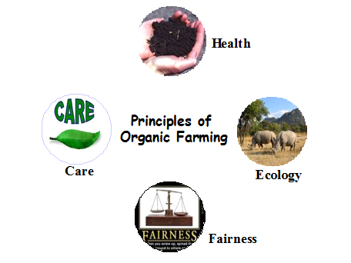
ORGANIC FARMING PRINCIPLE

Slide 8
Four Principles
1. Principle of health
Organic Agriculture should sustain and enhance the health of soil, plant, animal, human and planet as one and indivisible
Healthy soils produce healthy crops that foster the health of animals and people.
Health is the wholeness and integrity of living systems.
The role of organic agriculture, whether in farming, processing, distribution, or consumption, is to sustain and enhance the health of ecosystems and organisms from the smallest in the soil to human beings.

Slide 9
2. Principle of ecology
Organic Agriculture should be based on living ecological systems and cycles, work with them, emulate them and help sustain them.
This principle roots organic agriculture within living ecological systems.
It states that production is to be based on ecological processes, and recycling
Nourishment and well-being are achieved through the ecology of the specific production environment.
Organic management must be adapted to local conditions, ecology, culture and scale.

Slide 10
3. Principle of fairness
Organic Agriculture should build on relationships that ensure fairness with regard to the common environment and life opportunities.
This principle emphasizes that those involved in organic agriculture should conduct human relationships in a manner that ensures fairness at all levels and to all parties - farmers, workers, processors, distributors, traders and consumers
Previous
Next
End

Slide 11
4. Principle of care
Organic Agriculture should be managed in a precautionary and responsible manner to protect the health and well-being of current and future generations and the environment.
Organic agriculture is a living and dynamic system that responds to internal and external demands and conditions.
This principle states that precaution and responsibility are the key concerns in management, development and technology choices in organic agriculture.

Slide 12
Basic Steps of Organic Farming
Organic farming approach involves following five principles:
1. Conversion of land from conventional management to organic management
2. Management of the entire surrounding system to ensure biodiversity and sustainability of the system
3. Crop production with the use of alternative sources of nutrients such as crop rotation, residue management, organic manures and biological inputs.
4. Management of pests by better management practices, physical and cultural means and by biological control system
5. Maintenance of livestock with organic concept and make them an integral part of the entire system

Slide 13
Advantages of Organic Farming
Farmers can reduce their production costs because they do not need to buy expensive chemicals and fertilizers.
Healthier farm workers.
In the long term, organic farms save energy and protect the environment.
It can slow down global warming.
There is an increasing consumer are willing to pay more for organic foods.
More animals and plants can live in the same place in a natural way. This is called biodiversity.

Slide 14
Disadvantages of Organic Farming
Organic food is more expensive because farmers do not get as much out of their land as conventional farmers do. Organic products may cost up to 40% more.
Marketing and distribution is not efficient because organic food is produced in smaller amounts.
Food illnesses may happen more often.
Organic farming cannot produce enough food that the world’s population needs to survive. This could lead to starvation in countries that produce enough food today.

Slide 15
THANK YOU

